Slide 1

SUPERVISED BY
Dr.A.Udayakumar/Designation
PRESENTED BY
1. V.DINESH (26056)(23UECS0586)
2. K.SAI SRUJANA (25926)(23UECS0301)
3. M.SRINIJA (25223)(23UECS1131)

Slide 2
Design & develop a smart Shopfloor Noise Heatmap Generator for safety improvement
AGENDA
Introduction
Literature Survey
Problem Statement
Proposed System Architecture
Proposed Methodology
Conclusion and Future Work
References

Slide 3
Introduction
Problem Statement:
Industries lack an efficient real-time system to monitor and visualize noise levels across the shopfloor, which leads to unrecognized hazardous noise zones and risks to worker health
Project Goal:
To design and develop a smart system that continuously monitors shopfloor noise levels and generates a real-time heatmap to identify high noise areas
Brief Overview:
The system uses sound sensors placed at different locations to collect noise data. The data is processed using software and displayed as a heatmap using color coding, where high noise areas are highlighted clearly.

Slide 4
Literature Survey
Existing Systems and Related Works:
Existing noise monitoring systems include:
• Manual sound level measurement using decibel meters
• Fixed noise monitoring systems without visualization
• Basic IoT monitoring systems without spatial mapping
• Workplace safety monitoring systems with limited real-time alerts

Slide 5
Problem Statement
Limitations of Existing Solutions
1. Sensor Accuracy Issues
Low-cost sound sensors (like KY-037 / KY-038) may not give precise decibel readings.
Background vibrations, machines, or wind can cause false noise values.
Requires calibration for reliable results.
2. Limited Coverage Area
A single sensor can only monitor a small region.
For large shopfloors, multiple sensors are required, which increases cost and complexity.
3. Network Dependency
System depends on Wi-Fi / Internet connectivity.
If network fails, real-time heatmap and alerts stop working.
4. Power Supply Constraints
Continuous monitoring needs stable power.

Slide 6
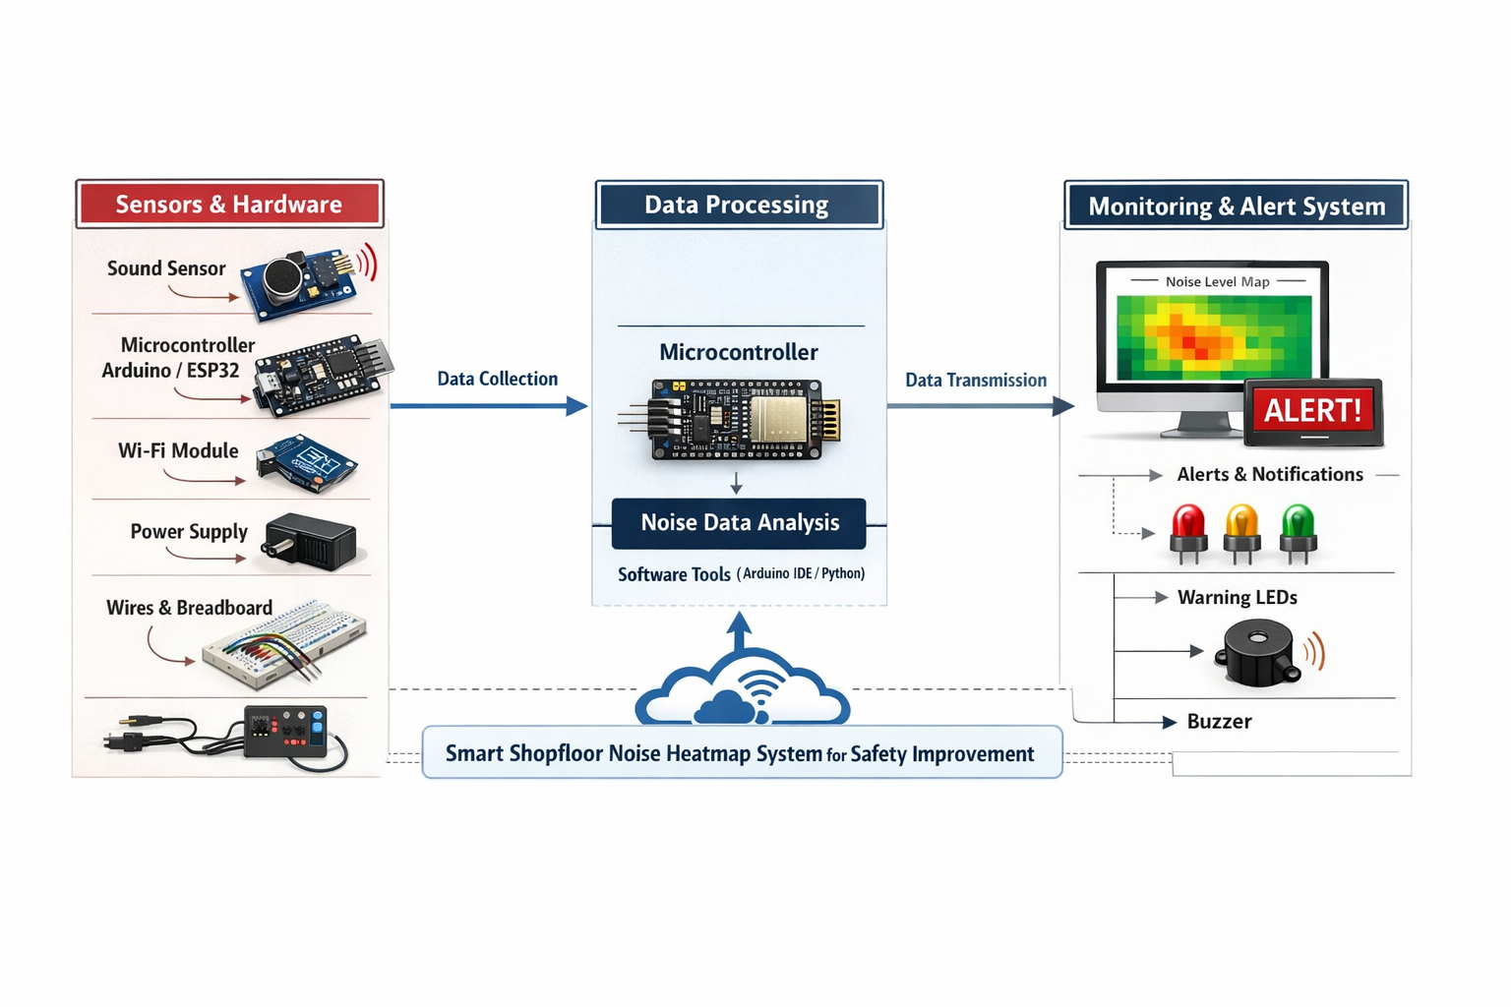
Proposed System Architecture

Slide 7
Proposed Methodology Outline the methodologies that showcase how your project differs or improves:
Sound sensors collect noise level data continuously
Microcontroller reads and sends data to computer
Software processes the received data
Noise levels are categorized into ranges
Heatmap is generated using color coding • Green – Safe noise level • Yellow – Moderate noise level • Red – High noise level
Heatmap is displayed to the user

Slide 8
Summary of Module -1
Noise Data Collection Module
• Sound sensors are installed at different locations on shop floor • Sensors continuously monitor surrounding noise levels • Sensors convert sound waves into electrical signals • Microcontroller (Arduino / ESP32) reads sensor data • Data is collected at regular time intervals • Each sensor is assigned a specific location ID

Slide 9
Summary of Module -2
Data Processing Module
• Raw sensor data is received from microcontroller • Noise levels are calculated in decibels (dB) • Data filtering is applied to remove unwanted noise • Noise values are categorized to safe, moderate, and high level • Location-wise data is organized systematically • Processed data is stored temporarily for visualization

Slide 10
Summary of Modules -3
Heatmap Generation Module
• Processed noise data is mapped with location coordinates • Heatmap is generated using visualization libraries • Different colors represent different noise intensities • Green indicates safe levels • Yellow indicates moderate levels • Red indicates high/danger levels

Slide 11
Summary of Modules -4
Visualization and Monitoring Module
• Displays real-time heatmap on the system screen • Shows noise levels of each monitored area • Allows supervisors to monitor shopfloor conditions • Provides easy-to-understand graphical interface • Helps in maintaining workplace safety standard

Slide 12
Hardware Requirements Specification
Hardware Requirements
• Sound Sensor (Microphone module)
• Microcontroller (Arduino / ESP32)
• Computer / Laptop
• Connecting wires

Slide 13
Software Requirements Specification
• Python
• Arduino IDE
• Heatmap visualization libraries (Matplotlib / Seaborn)
• Operating System: Windows

Slide 14
Conclusion and Future Work
Conclusion
The Smart Shopfloor Noise Heatmap Generator provides an efficient solution for real-time noise monitoring and visualization. It helps identify high noise areas and improves worker safety and workplace efficiency.
Future Work
• Add real-time alerts for dangerous noise levels • Cloud storage integration • Mobile application support • AI-based noise prediction • Integration with industrial safety systems

Slide 15
References
Starke, R. A., Gerges, R. N. C., Dias, R. A., Noll, V., Hamad, A. F., Laporte, J. V. F., & Ratola, F. C. (2024). Real-time industrial noise mapping with IoT systems. International Journal of Computer Applications, 186(43), 33–39.
Kumar, A., & Singh, B. (2024). Wireless acoustic sensor networks for industrial environment monitoring. IEEE Sensors Journal, 24(5), 4120–4128.
Fernandez, L., & Costa, P. (2025). Spatial noise mapping using wireless IoT nodes and heatmap visualization. IEEE Smart Cities Conference Proceedings, 155–160.
Nguyen, T., & Tran, Q. (2025). LoRa-enabled acoustic monitoring and safety alert system for smart factories. IEEE International Conference on IoT Systems Engineering, 210–215.
Brown, M., & Smith, J. (2024). Low-cost IoT sound monitoring platforms for smart industrial environments. IEEE Internet of Things Journal, 11(3), 2150–2160.

Slide 16
THANK YOU

